Slide 2
Generic Change Detection all over France
Michelle AUBRUN
michelle.aubrun@thalesaleniaspace.com

Slide 3
Summary
Project presentation
Use case presentation
Issue encountered

Slide 4
Project presentation
1

Slide 5
Project : Evolve
H2020 : HPC and Cloud enhanced Test-beds for Extracting Value from Large-scale Diverse Data
19 partners (11 European countries)
Objectif : Ability to process unprecedented amounts of data and handle demanding computations via :
Platform with HPC features (HPC world)
Versatile database processing stack for end-to-end workflows (Big Data world)
Easy deployment, access, use and share (Cloud world)

Slide 6
Use case presentation
2

Slide 7
Use case : Change Detection
Satellite image : Sentinel-2
Objectif : Detect generic changes over the entire France during 1 year with a revisit period of 10 days.
Lot of applications in many diverse sectors :
Land surveillance (deforestation, urbanization)
Disaster (forest fire, frozen crop)
Climatic change

Slide 8
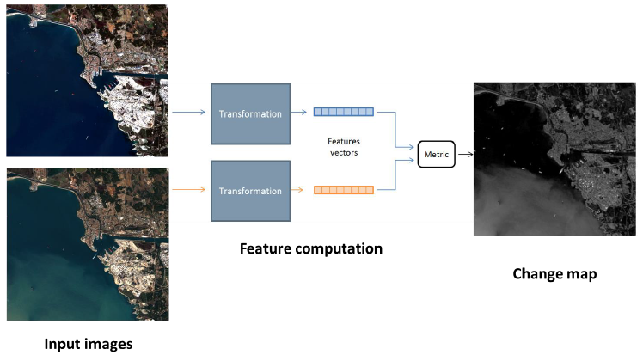
Use case : Change Detection
Encode Sentinel-2 images into a relevant feature space with an adequat loss function :
Insensitive to atmospheric conditions
Compute a distance metric in this space in order to generate change detection map

Slide 9
Issue encountered
3

Slide 10
Main issue : Storage and Access
One Sentinel-2 image :
Data volume : about 700 Mo
Granule : 10 000 x 10 000 pixels (100km x 100km)
Use case objectif :
About 100 granules to cover France territory
35 revisit for a period of 1 year
Storage = About 2,5 To of input data + storage of results (e.g. change detection map)

